Slide 1
The Benefits of Bike-Specific Infrastructure by Russell Andlauer

Slide 2
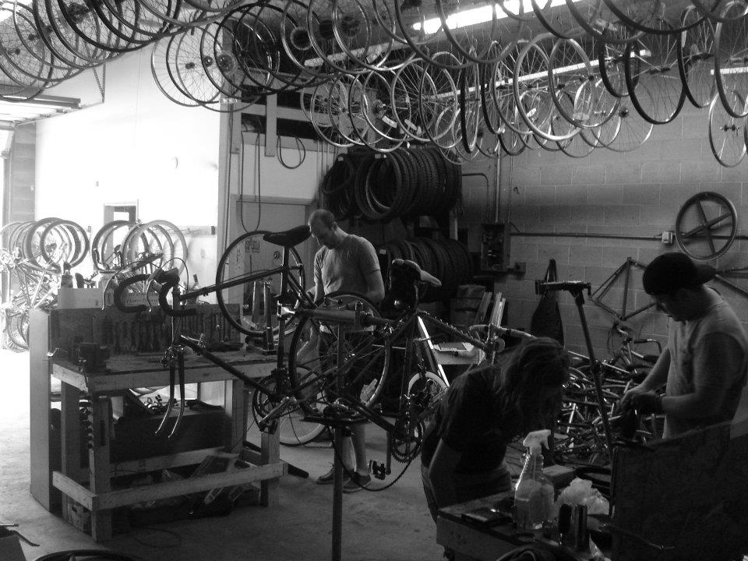
Provo Bicycle Collective

Slide 3
More Bike Commuters = Problem Reductions
Encourage More Active Lifestyle
Improve Sense of Community
Reduce Traffic Congestion
Curb Pollution
Improve Health

Slide 4
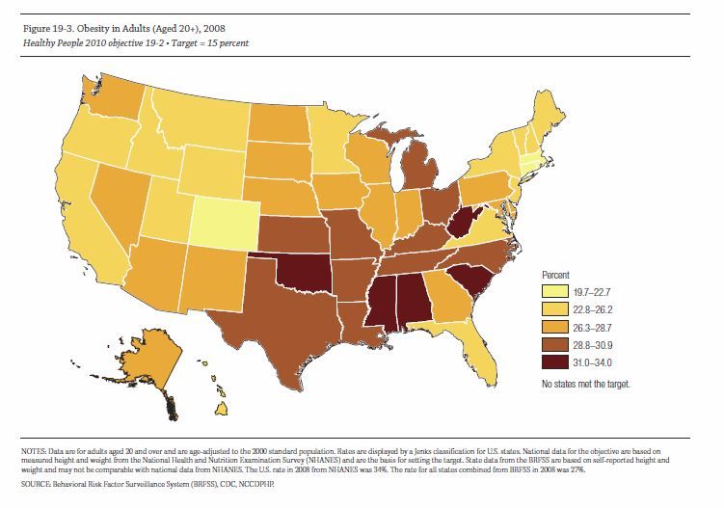
Obesity is a HUGE Problem

Slide 5
Call to Action
Citizens
-Consistent Pressure on Lawmakers
Elected Officials
-use Multiple Streams Approach

